Slide 1
INFO 7374 FUNCTIONAL API

Slide 2
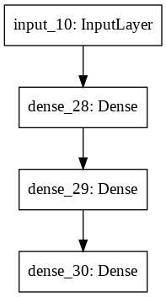
Densely connected NETWORKS:
A dense network is a network in which the number of links of each node is close to the maximal number of nodes. Each node is linked to almost all other nodes.

Slide 3
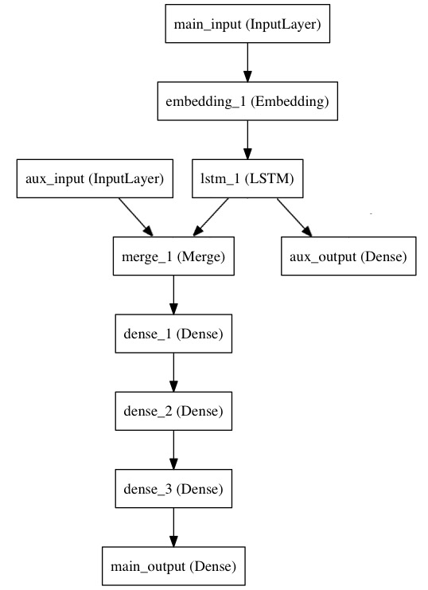
Multiple input multiple output model:

Slide 4
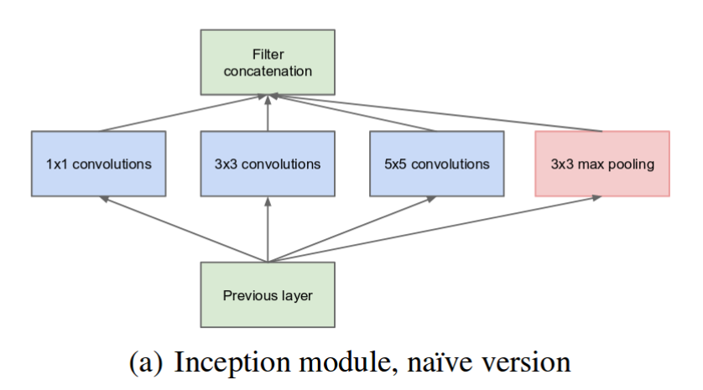
Inception model:
The concept of Inception module focuses on the kernel size.

Slide 5

Salient parts in the image can have an extremely large variation in size
.

Slide 6
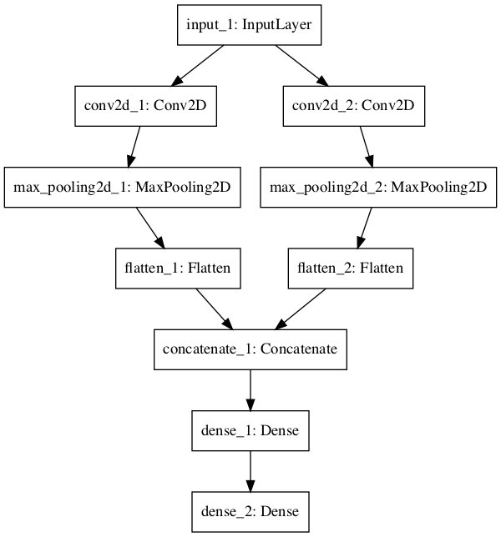
Shared layers:
LAYERED NODE

Slide 7
Applications of Functional api
Inception Module
Residual connection on convolutional layer
Convolutional layer
Shared vision model
Visual & Video question answering model

